Slide 1
Systematic Literature Review
Challenges and Opportunities
Ivica Crnkovic
ivica.crnkovic@mdh.se

Slide 2
Empirical SE Questions?
The questions similar to those an anthropologist might ask during first contact with a previously unknown culture.
  How do people learn to program?
  Can the future success of a programmer be predicted by personality tests?
  Does the choice of programming language affect productivity?
  Can the quality of code be measured?
  Can data mining predict the location of software bugs?
  …….
Greg Wilson, Jorge Aranda, Empirical Software Engineering, American Scientist
https://www.americanscientist.org/issues/pub/empirical-software-engineering

Slide 3
Empirical Software Engineering
Evidence of particular aspect of SE
  Activities, processes, technologies
  Best practices, Lessons learned
  Increased knowledge
  Showing a new perspective of a particular knowledge.
  ….

Slide 4
Empirical Software Engineering Methods
Case studies
Surveys
Literature reviews

Slide 5
Systematic Literature Review (SLR)
Finding evidence from (scientific) literature
  Do it in a systematic way
    State a question
    Find the answer
Based on
Barbara Kitchenham, Evidence-Based Software Engineering and Systematic Reviews
www.scm.keele.ac.uk/ease/ease05_bk.ppt

Slide 6
Systematic (Literature) Review
Questions
  what are the current problems in a specific area?
  for a specific problem what are the reported solutions?
  Which are the newest results in a particular area?
  Which particular combination of two/several areas do exist?
Important!
  The questions should be interesting form a research point of view
  The questions should be attractive for the readers
  The questions should be enough general to come to a conclusions that are sufficiently general
  The questions should be specific enough to be able to provide enough specific findings

Slide 7
Systematic Review Procedure
Support Evidence-based paradigm
  Start from a well-defined question
    Step 1
  Define a repeatable strategy for searching the literature
    Step 2
  Critically assess relevant literature
    Step 3
  Synthesise literature
    Step 4
Ref: Barbara Kitchenham, Evidence-Based Software Engineering and Systematic Reviews

Slide 8
Systematic Review Process
Develop Review Protocol
Plan Review
Validate Review Protocol
Identify Relevant Research
Select Primary Studies
Conduct Review
Assess Study Quality
Extract Required Data
Synthesise Data
Write Review Report
Document Review
Validate Report

Slide 9
Showing the SLR through an example
Example #1
Example 1:
A systematic review of software architecture evolution research.
Hongyu Pei Breivold, Ivica Crnkovic, Magnus Larsson,
Information & Software Technology 54(1): 16-40 (2012)
software evolvability
  the ability of a system to accommodate changes in its requirements throughout the system’s lifespan with the least possible cost while maintaining architectural integrity”
Interest: evolvability through software architecture

Slide 10
Evolvability property model
is refined to
Evolvability
subcharacteristics
1
1..*
1
is refined to
1..*
measured by
measuring attributes
1..*
metrics
1
1
reason about
1..*
QoS
Evolvability subcharacteristics
Analyzability
Architectural Integrity
Changeability
Portability
Extensibility
Testability
Domain-specific attributes
Question: which are subcharacteristics?

Slide 11
Showing the SLR through an example Example #2
Example 2:
15 Years of CBSE Symposium: Impact on the Research Community
Josip Maras, Luka Lednicki, Ivica Crnkovic
ACM/SigSoft Component-based Software Engineering Symposium 2012
Interest: What is the impact of CBSE Symposium publications?

Slide 12
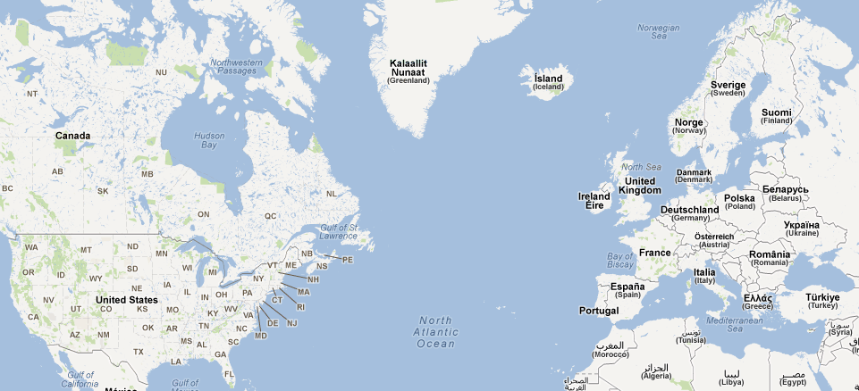
CBSE events
1998 – Tokyo
1999 – Los Angeles
2000 – Limerick
2001 – Toronto
2002 – Orlando
2003 – Portland
2004 – Edinburgh
2005 – St. Louis
2006 – Västerås
2007 – Boston
2008 – Karlsruhe
2009 – E. Stroudsburg
2010 – Prague
2011 – Boulder
2012 - Bertinoro
1998 – Tokyo
1999 – Los Angeles
2000 – Limerick
2001 – Toronto
2002 – Orlando
2003 – Portland
2004 – Edinburgh
2005 – St. Louis
2006 – Västerås
2007 – Boston
2008 – Karlsruhe
2009 – E. Stroudsburg
2010 – Prague
2011 – Boulder
2012 - Bertinoro
Workshop@ICSE
Initiation
Focus
Symposium@ICSE
Broadening Scope
QoSA
CompArch
Symposium!@ICSE
WCOP
Collaboration phase
ISARCS
(WICSA)

Slide 13
Systematic Review Process
Develop Review Protocol
Plan Review
Validate Review Protocol
Identify Relevant Research
Select Primary Studies
Conduct Review
Assess Study Quality
Extract Required Data
Synthesise Data
Write Review Report
Document Review
Validate Report

Slide 14
Developing the Protocol
Review protocol
  Specifies methods to be used for a systematic review
  Predefined protocol
    Reduces researcher bias by reducing opportunity for
      Selection of papers driven by researcher expectations
      Changing the research question to fit the results of the searches
  Good practice for any empirical study

Slide 15
Protocol Contents -1/3
Background
  Rationale for survey
Research question
  Critical to define this before starting the research
  Strategy used to search for primary sources

Slide 16
Protocol Contents – 2/3
Strategy to find primary studies
  Search terms/keywords
  Identify resources, databases, journals, conferences
  Procedures for storing references
  How publication bias will be handled
    Grey literature
    Direct approach to active researchers
  How completeness will be determined
    Useful to have the baseline paper to set start date
Selection Strategy
  Inclusion/exclusion criteria
    Handling multiple papers on one experiment
    Quality assessment criteria

Slide 17
Protocol Contents- 3/3
Data extraction
  What data will be extracted from each primary source
  How to handle missing information
  How data extraction reliability will be addressed
    Usually multiple reviewers
  Where data will be stored
Procedures for data synthesis
  Formats for summarising data
  Measures and analysis if meta-analysis is proposed

Slide 18
Research questions
Search Keywords
Resources/Database
Search
Studies
Inclusion/Exclusion criteria
SLR process
filtering
Primary Studies
legend
analysis
Statistical data
activity
synthesis
New findings
artifact

Slide 19
Example 1 (Software Architecture Evolution)
Research questions
What approaches have been reported regarding the analysis and achievement of software evolvability at the architectural level?
What are the main research topics covered in the scientific literature regarding analysis and achievement of evolvability-related quality attributes?
…..
What is the impact of the studies to research community and practice?

Slide 20
Example 1 (Software Architecture Evolution)
Research questions
Search Keywords
Resources/Database
Search keywords
S1: software architecture AND evolvability
S2: software architecture AND maintainability
S3: software architecture AND extensibility
S4: software architecture AND adaptability
S5: software architecture AND flexibility
S6: software architecture AND changeability
S7: software architecture AND modifiability
S8: software architecture AND analyzability
Databases & Resources:
ACM Digital Library
IEEE Xplore
ScienceDirect – Elsevier
SpringerLink
Wiley InterScience
ISI Web of Science
SCOPUS
(Google Scholar )
Keywords should reflect the questions and the underlying theory/model

Slide 21
Example 2 (CBSE publications)
Research questions
Questions
Impact
Number of publications, total, per year, geographical distribution
citation index
Indirect impact: backward citations, Impact of the authors
What is the maturity level of CBSE?
Topics of interest
Which research topics where the most present at CBSE?
What kind of research results were presented?
What type of validations the publications had?

Slide 22
Example 2 (CBSE publications)
Research questions
Search Keywords
Resources/Database
Questions
Impact
Publications
citation index
Indirect impact
Topics of interest
Search keywords
No search keywords
- all CBSE papers
Databases & Resources:
CBSE Proceedings
SpringerLink
ACM Didgital Library
Google Scholar
Web search

Slide 23
Example 1: Primary studies selection process
Search
Studies
filtering
Primary Studies

Slide 24
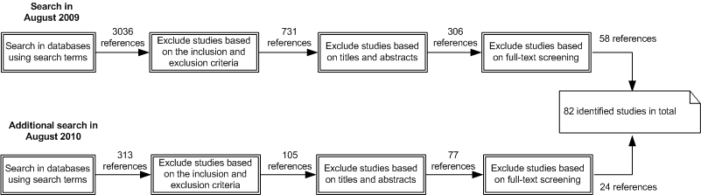
Example 1: Primary studies selection process
Search
Studies
filtering
Primary Studies

Slide 25
Example 1: Primary studies selection process
Search
Studies
filtering
Primary Studies
Activities:
  Provide search strings in databases and export the results to EndNote
    Tedious work – different query languages and different export functionality
  Extraction of the information in a suitable form for reading and selecting, removing duplicates, etc.
Goal:
  To get a reasonable number of studies (<500, >20)
    May require refinement of the questions
  Achieve reliability – select the most significant literature

Slide 26
Example 2 (CBSE publications)
Search
Studies
filtering
Primary Studies
All publications are primary studies
  318 studies
Activities
  Extract publications and create an relational-database
  Populate database
  Provide “Query and View” interactive web-based application for fast reading and publication classification

Slide 27
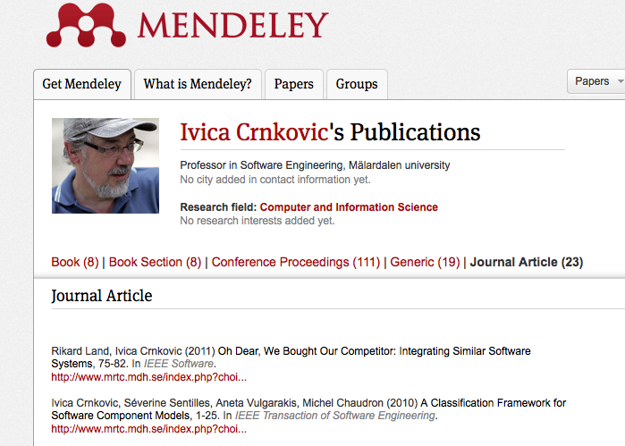
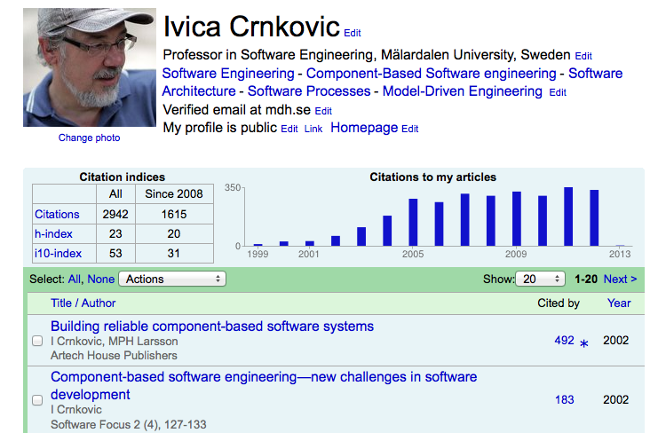
analysis
Statistical data
Data extracted from the studies – “objective data”
  Distribution of studies with respect to
    Year of publications
    Authors and research communities
    Sources of publications
    Citation distribution, the most cited studies
Analysis support
  Manual, writing own software,
  Help from some tools/portals
    Google scholar
    Perish & publish
    Mendeley,…

Slide 28
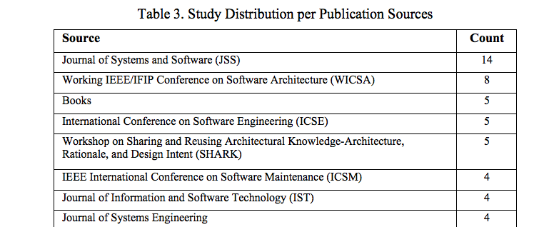
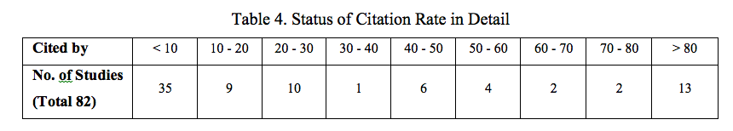
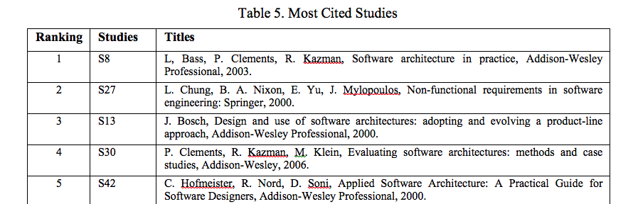
Example 1: statistical data
analysis
Statistical data

Slide 29
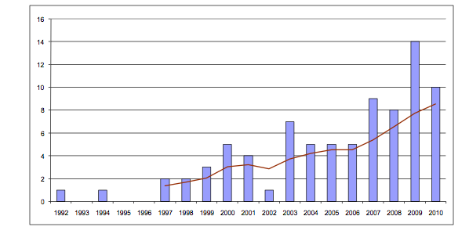
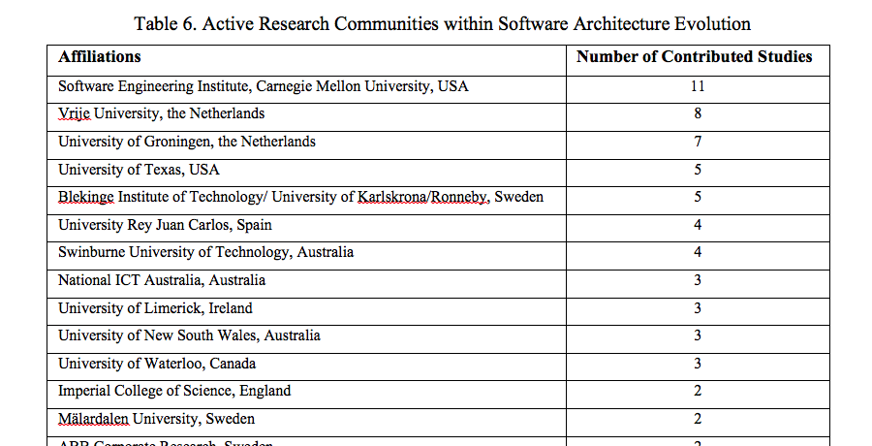
analysis
Statistical data
Example 1: statistical data

Slide 30
analysis
Statistical data
Example 2: statistical data
#citations - total: 3405 –
(measured 2012-02-12)
# citations per year

Slide 31
analysis
Statistical data
Example 2: statistical data
Top 10 citations
Citation of papers
that cited top 10 papers
The most influential
Authors from CBSE
(citations of the related work)

Slide 32
Procedures for data synthesis
synthesis
New findings
Goal: synthesize the information into a new knowledge
  Based on a theory previously established
    Validation of the theory
    Description of some specific characteristics of the theory
  Grounded theory
    Build up a theory from the reading & analysis
      Manual
      Using some tools – the most frequent words, Concordance
The most difficult part
  Requires experience and knowledge in the subject
  Requires a kind of validation/review

Slide 33
synthesis
New findings
Example 1 (Software Architecture Evolution)

Slide 34
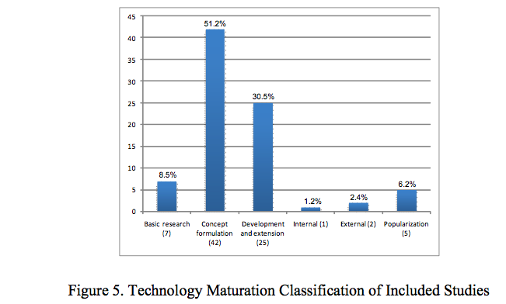
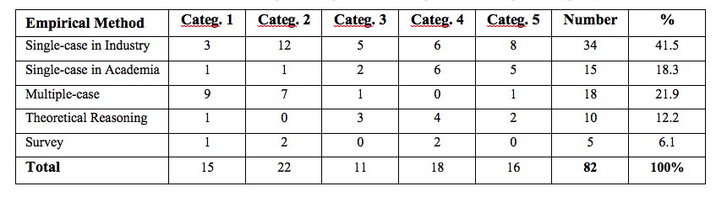
synthesis
New findings
Example 1 (Software Architecture Evolution)
Maturity classification:
Basic research
Concept formulation
Development and extension
Internal use
External use
Popularization

Slide 35
synthesis
New findings
Example 2 (CBSE publications)
Research Area
Result characteristics
Procedures or techniques
Qualitative models
Analytic models
Notations or tools
Specific solutions
Judgments
Reports
Empirical models

Slide 36
synthesis
New findings
Example 2 (CBSE publications)
Evaluation Type
Not presented
Academic case study
Simple examples
Experiments
Industrial case study
Formal specification
Literature review
Research Maturity
External enhancement and exploration
Internal enhancement and exploration
Development and extension
Conceptual formulation

Slide 37
Validation issues
0. Is your approach OK?
  Do you have the right questions?
  Is the procedure feasible?
How you can ensure that you have selected the right studies?
How you can ensure that your analysis and synthesis is right?

Slide 38
The right studies?
Are the selected sources appropriate
  Selection of databases important (fortunately there are not so many)
  Is Google/Google Scholar appropriate as a source?
Have you missed to select some important studies? Do you have too many unimportant studies?

Slide 39

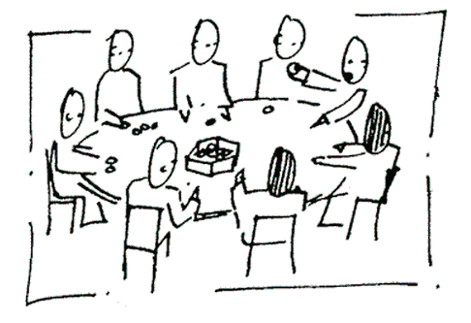
Studies selection
Several researchers involved in the process
Selected studies A
Selected studies
using automatic
queries
Δ
Selected studies B
comparison
Discussion
Selected studies C
Filtering
Final list

Slide 40
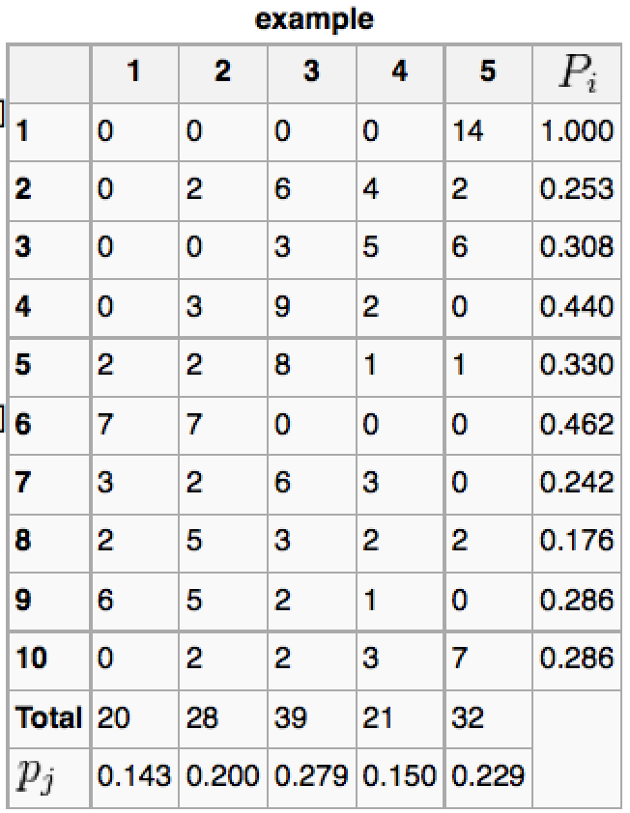





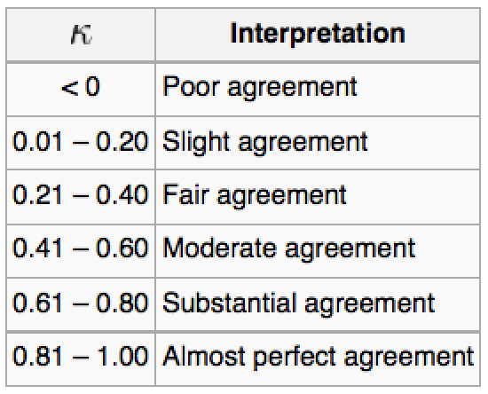
Comparison
Agreement? → Fleiss’ kappa

Slide 41


Synthesis/Findings Validation
Your analysis/synthesis is based on a theory/model
  Existing classification, ontology
  Previous research results
  Extending/refinement of the existing theories
You build your theory/model from start
Iterative process – building & validation
Validation by a
third person
Synthesis
Discussion

Slide 42
Reporting results
Several levels of information
  Raw source information
  Extensive detailed technical report
  Research papers (Journal, Conference) – reference to source data, technical report

Slide 43
Write an SLR paper 1/2
Intro
  Motivation – the most important
    Why the question is interesting
    What is the main question
The overall method used
    The questions, the search keywords, source of information
    Election process, data storage
Selected studies
    Refer to the most important studies
    Provide statistics, comment them

Slide 44
Write an SLR paper 2/2
Synthesis – Important
  The findings (short description in general)
  The findings related to the studies (classification/grouping of the studies)
Discussion
  Additional findings, remarks, statistics from the studies related to the findings
Validation
  Validation threat
  Validation procedures (this can be specified in the methods part)
Conclusion
List of primary studies
references

Slide 45
Some Research Databases
SCOPUS http://www.scopus.com/home.url
ACM Digital Library (http://portal.acm.org)
Compendex (http://www.engineeringvillage.com)
IEEE Xplore (http://www.ieee.org/web/publications/xplore/)
ScienceDirect – Elsevier (http://www.elsevier.com)
SpringerLink (http://www.springerlink.com)
Wiley InterScience (http://www3.interscience.wiley.com)
ISI Web of Science (http://www.isiknowledge.com).

Slide 46
References for the systematic review
Kitchenham, Barbara. Procedures for Performing Systematic Reviews, Joint Technical Rreport, Keele University TR/SE-0401 and NICTA 0400011T.1, July 2004.
Australian National Health and Medical Research Council. How to review the evidence: systematic identification and review of the scientific literature, 2000. IBSN 186-4960329 .
Australian National Health and Medical Research Council. How to use the evidence: assessment and application of scientific evidence. February 2000, ISBN 0 642 43295 2.
Cochrane Collaboration. Cochrane Reviewers’ Handbook. Version 4.2.1. December 2003.
Glass, R.L., Vessey, I., Ramesh, V. Research in software engineering: an analysis of the literature. IST 44, 2002, pp491-506
Magne Jørgensen and Kjetil Moløkken. How large are Software Cost Overruns? Critical Comments on the Standish Group’s CHAOS Reports, http://www.simula.no/publication_one.php?publication_id=711, 2004.
Magne Jørgensen. A Review of Studies on Expert Estimation of Software Development Effort. Journal Systems and Software, Vol 70, Issues 1-2, 2004, pp 37-60.

Slide 47
References for the systematic review
Khan, Khalid, S., ter Riet, Gerben., Glanville, Julia., Sowden, Amanda, J. and Kleijnen, Jo. (eds) Undertaking Systematic Review of Research on Effectiveness. CRD’s Guidance for those Carrying Out or Commissioning Reviews. CRD Report Number 4 (2nd Edition), NHS Centre for Reviews and Dissemination, University of York, IBSN 1 900640 20 1, March 2001.
Pai, Madhukar, McCullovch, Michael, Gorman, Jennifer D., Pai, Nitika, Enanoria, Wayne, Kennedy, Gail, Tharyan, Prathap, Colford, John M. Jnr. Systematic reviews and meta-analysis: An illustrated, step-by-step guide. The National medical Journal of India, 17(2) 2004, pp 86-95.
Sackett, D.L., Straus, S.E., Richardson, W.S., Rosenberg, W., and Haynes, R.B. Evidence-Based Medicine: How to Practice and Teach EBM, Second Edition, Churchill Livingstone: Edinburgh, 2000.

